Slide 1

Multimedia to Database
We'll explore various methods for handling audio, video, and text data, along with practical examples to solidify your understanding.

Slide 2
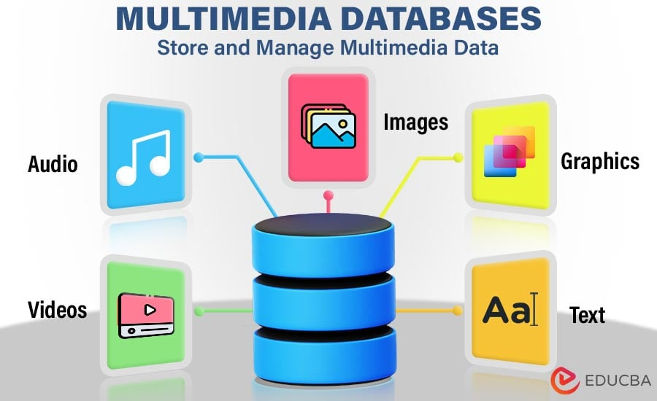
UPLOADING
Multimedia To Database

Slide 3

Multimedia
The integration of multiple forms of media, such as :
Text, Audio, Video, Graphics, and interactivity, to deliver information dynamically and interactively

Slide 4
Storage and Retrieval of Multimedia
Storing multimedia content is essential for many applications, including content management systems, streaming services, and cloud storage platforms.
Different types of multimedia such as audio, video, and text—require different approaches for efficient storage and retrieval.

Slide 5



Slide 6

More Pixels, More Clarity!

Slide 7


Slide 8

Computers see pixels, we see pictures!

Slide 9


Slide 10


Slide 11


Slide 12


Slide 13


Slide 14


Slide 15


Slide 16


Slide 17


Slide 18


Audio

Slide 19


Slide 20


Slide 21


Slide 22


Slide 23


Slide 24
Text
Storing Text as Standalone Data
Storing Text within Multimedia Files
Use database data types like VARCHAR, TEXT, or CLOB to store text data directly in the database. This is suitable for structured text, such as articles or product descriptions, enabling easy querying and indexing.
Extract text from multimedia files, such as captions or subtitles, and store it separately as metadata. This approach allows for independent indexing and retrieval of text, improving search functionality and accessibility.

Slide 25




Store Text in DB
Text as Standalone Data
1-Relational Database(Varchar / CLOB(Text))
. 2- JSON / XML
Text Embedded in Multimedia files
1- Extract and store as separate Metadata .
2-BLOB (Binary Large Object).
Store Files Direct in the database
1- BLOB (Binary Large Object)
2-Store Files Externally with Database References
3-Hybrid Approach: Store Text Content Separately

Slide 26

Storing Videos on Databases

Slide 27
On Database
Metadata is stored on database.
Video is stored in database as a BLOB file.
E.G. Vimeo

Slide 28
On Server
Metadata and video path is stored on database.
Video is stored on server (basic server of website).
E.G. YouTube

Slide 29
On Server (Separated)
Metadata is stored on database.
Video is stored on separated video server.
E.G. Netflix

Slide 30
Using a library
Using library like FFMPEG to convert video format into compatible formats as mp4, webM ..
Storing converted videos on database or on servers
Such as in Facebook

Slide 31

Practical Example: Uploading Files with SQL Server and C#
Create a Database Table
Define a table in your SQL Server database to store multimedia files. Use a VARBINARY(MAX) column to accommodate large binary data, including images, videos, and audio files.
Upload a File using C#
Utilize C# code to interact with the database and upload files. Employ the OpenFileDialog class to let users select files, read them as byte arrays, and store the data in the database table.
Retrieve and Save Files
Write C# code to retrieve multimedia files from the database based on their ID or other identifying information. Save the retrieved data to a specified location on the user's machine, enabling easy access and use.

Slide 32


